Slide 1
Scalable Feature Selection and Extraction with Applications in Kinase Polypharmacology
Derek Jones
Notes:
Hello everyone!
I want to thank everyone for being here, especially my committee, etc;
I appreciate everyone for taking time to hear about the work I’ve been doing over the past 2 years on computational drug discovery.

Slide 2
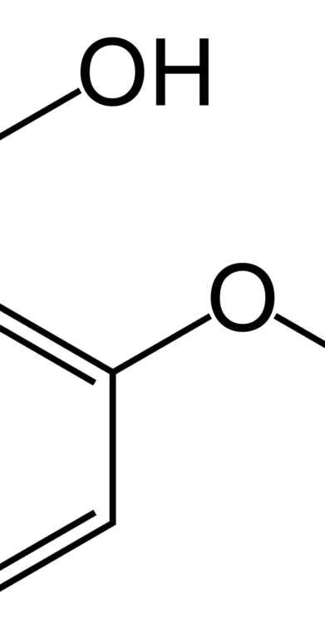
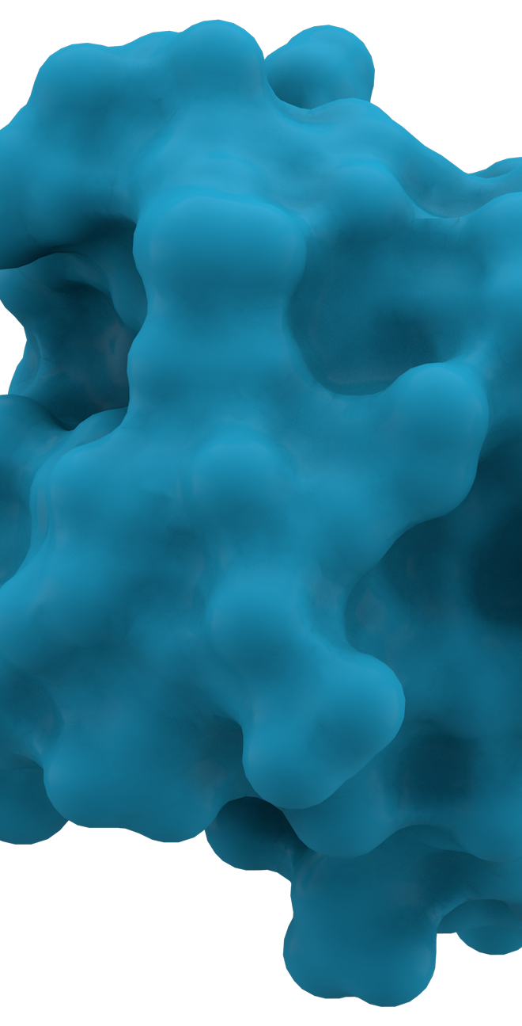
Drug Discovery
Notes:
The process through which potential new medicines are identified.
We focus on drug-protein interactions
Proteins: Proteins perform a vast array of functions within organisms, including DNA replication, responding to stimuli, and transporting molecules from one location to another.
Drug molecules allow us to manipulate the behavior of proteins in order to treat diseases such as cancer

Slide 3
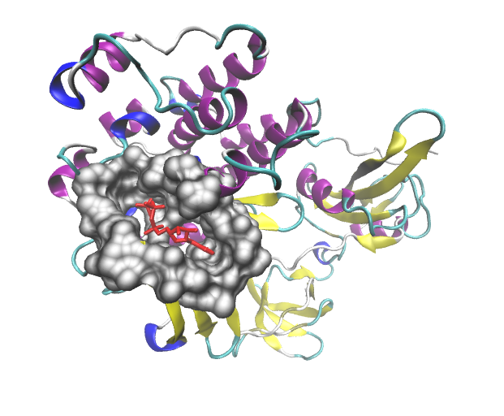
Drug-Protein Binding Interaction
Binding pocket on protein surface
Drug Molecule
Notes:
Two types of binding compounds, active and inactive

Slide 4
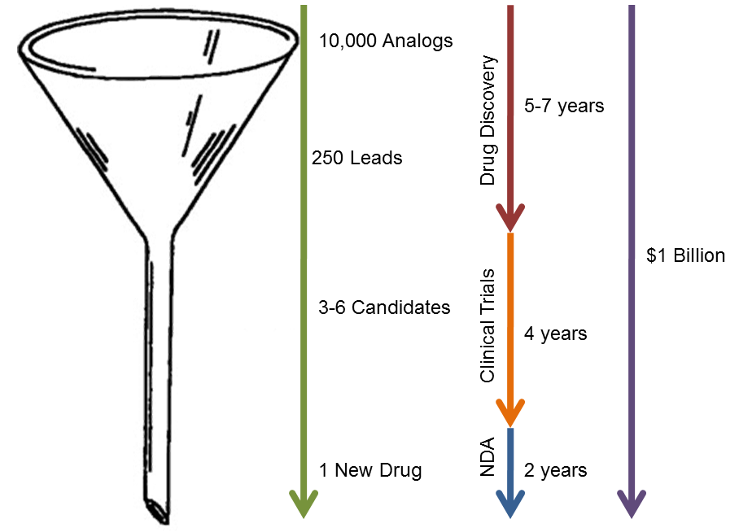
Predict here using virtual toxicity screen
Expensive stage for a drug to fail. Often due to ADRs.
_{Pipeline to New Drugs}
http://www.chemistry-blog.com/2012/01/04/tedtalk-medicine-for-the-99-hes-about-99-wrong/

Slide 5
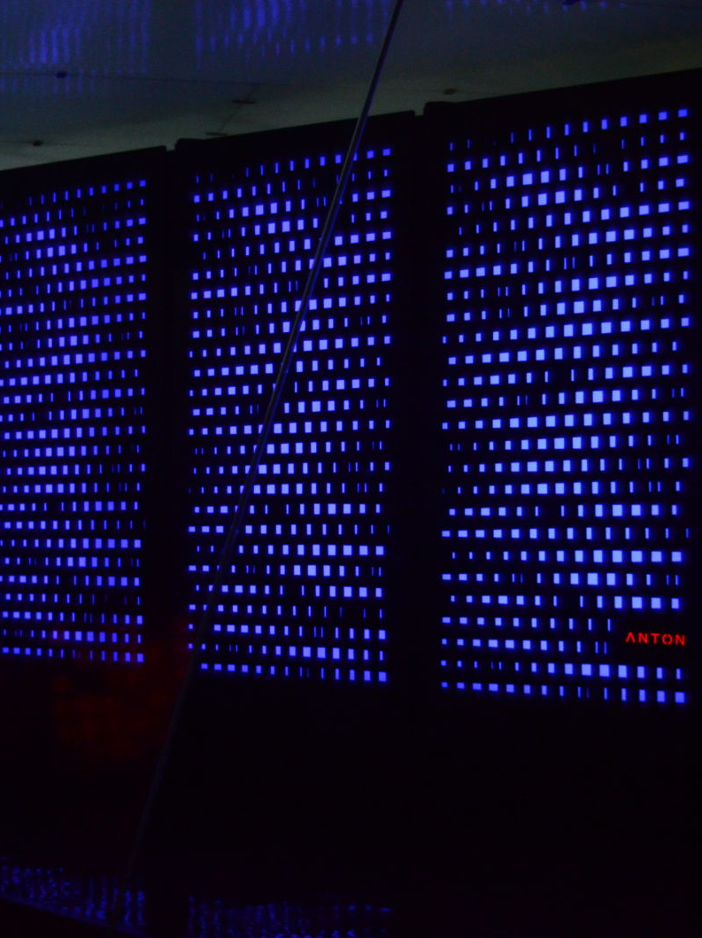
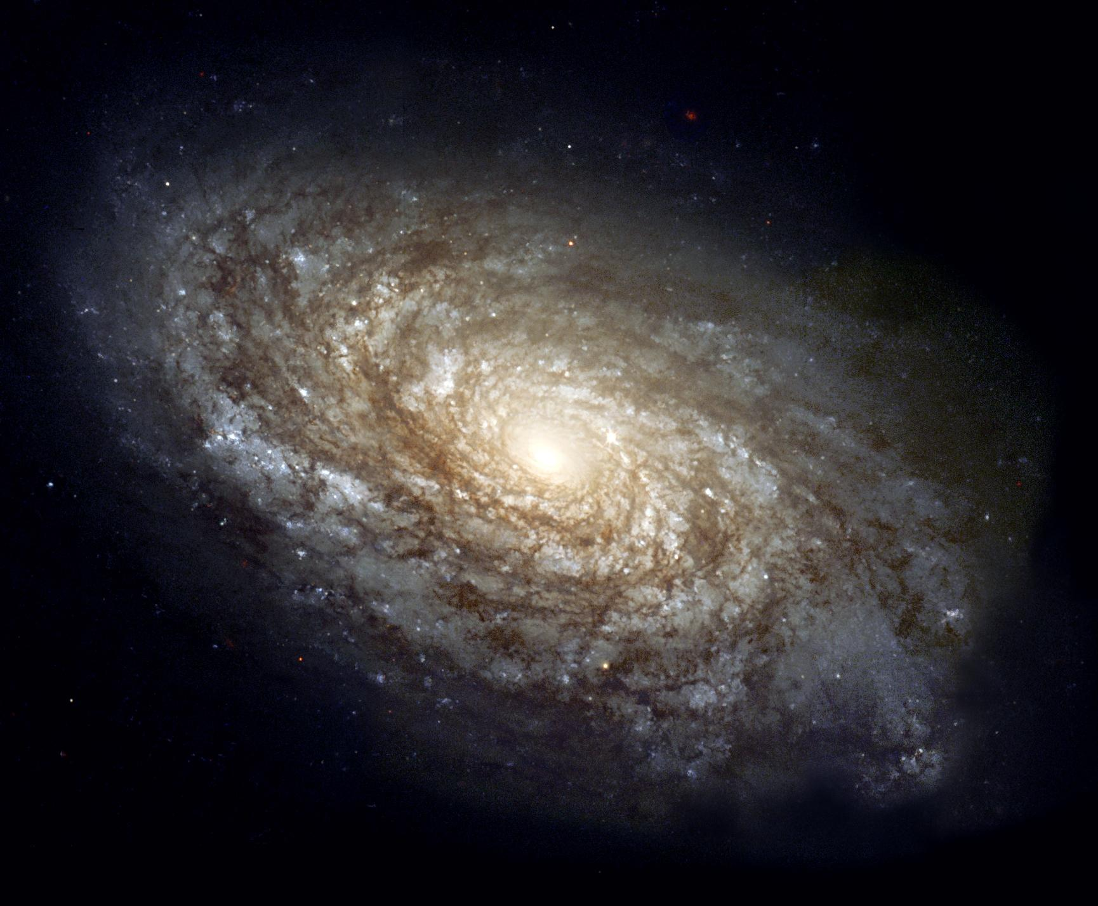
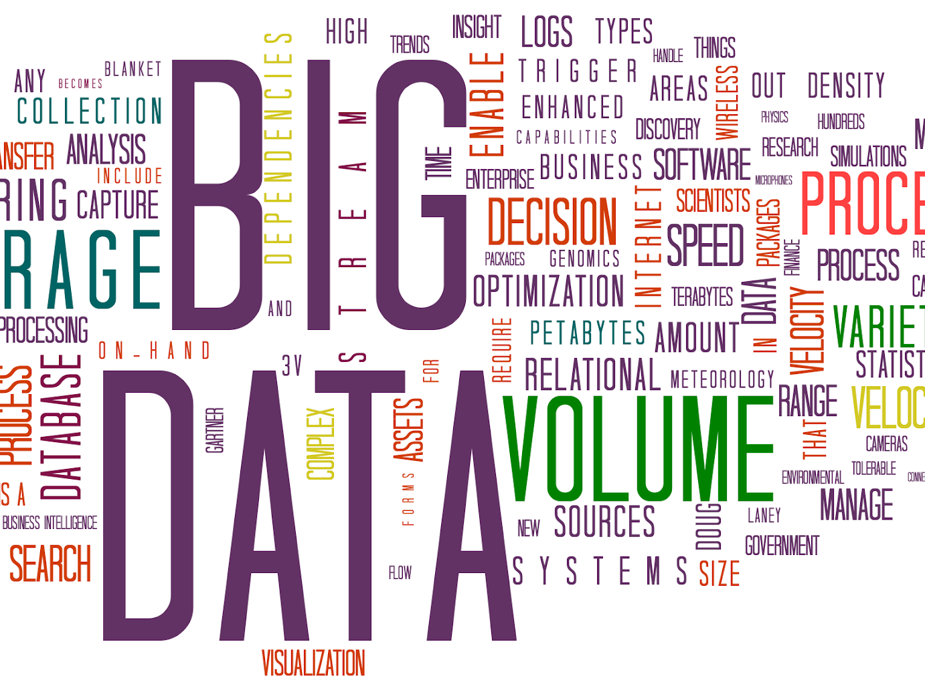
Challenges in Drug Discovery
Massive search space is estimated to be between 10²³ - 10⁶⁰
High-performance compute power required
Limited access to large quantities of data

Slide 6
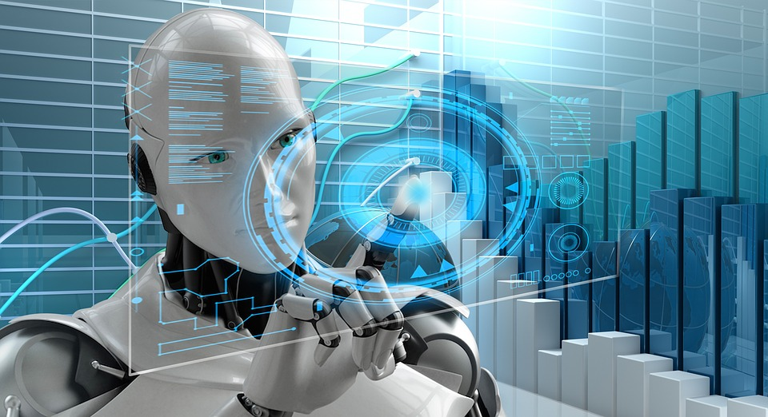
Improving Drug Discovery with Machine Learning
Good News:
More high quality open-source data is becoming available
Advancements in machine learning/deep learning and computational power
Our contribution:
Reduce the amount of domain expertise to reason about drug-protein binding interactions via data-driven approaches

Slide 7
Data-Driven Feature Selection in Binding Affinity Models
“Polypharmacology Within the Full Kinome: a Machine Learning Approach”, Derek Jones, Jeevith Bopaiah, Fatemah Alghamedy, Nathan Jacobs, Heidi Weiss, W.A. de Jong, Sally Ellingson, AMIA 2018 Informatics Summit, San Francisco
Notes:
Introduce a hard break for questions, mention the conference on the slide

Slide 8
Motivation
Protein kinases represent a large proportion of proteins that have essential functions
Kinases are difficult to target selectively
Potential treatments could likely lead to toxic off-target effects

Slide 9
Our Contributions
Expand the scope of previous multi-protein models by using a more comprehensive set of features
Compiled a large, high-dimensional dataset
Automatic feature selection algorithm to discard less informative information to handle the dimensionality
Notes:
Big Idea: reveiws the literature and use the combination of all feature extraction approaches

Slide 10
What are we trying to learn?
*We let active binding compounds be called the positive class and the inactive binding compounds referred to as the negative class

Slide 11
Methods: Data Collection
We derive our dataset of drug-protein pairs from the Directory of Useful Decoys-Extended (DUD-E) (Mysinger et. al)
1532 protein features derived from their sequences using a number of feature extraction servers
3850 drug features collected from the Dragon 7 molecular descriptor software
11 docking features collected from VinaMPI molecular docking software
38 binding pocket features using the prank software

Slide 12
Dataset Description
Binding features
Protein features
Pocket features
Drug features
complexes
Positive (active) vs Negative (inactive)
drug_{1,1}:protein_{1,1}
.
.
.
.
.
.
.
drug_{n,26}:protein_{26,1}
(0,1)
.
.
.
.
.
.
(0,1)
Unique for each drug
Unique for protein
Unique for each combination
Unique for each protein
Notes:
Emphasize how much work goes into making this thing, and describe the sequential process behnind it

Slide 13
Methods: Data Preprocessing
189 features with some portion of missing values
Eliminated 21 features with 23.1%-99.9% missing values, all drug features
Remaining 167 features with <= 5% missing, impute use the column mean
Notes:
Break up tlhe sentirences get rid of the …’s

Slide 14
Methods: Data Preprocessing
Full dataset after preprocessing:
5,410 features
361,786 examples
1:50 ratio between positive/negative class labels
Created training/testing sets using a stratified 80/20 split, keeping the proportion of positive class examples consistent across each split (~2%)

Slide 15
Methods: Feature Selection and Classification
We use the Random Forest (RF) as our classifier
RFs are composed of an ensemble of shallow decision trees trained on subsets of the full features
RFs can be robust to label imbalance and overfitting
Can extract GINI impurities to quantify “feature importance”, allowing the ability to perform automatic feature selection

Slide 16
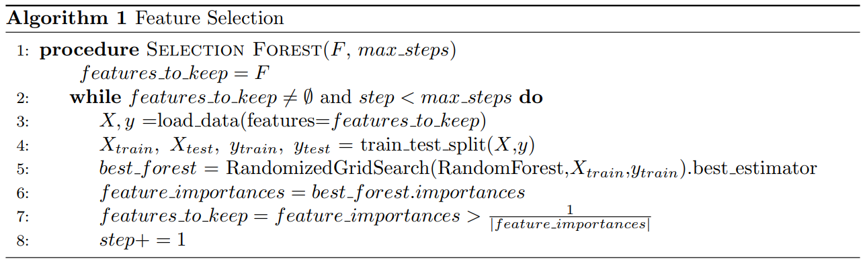

Slide 17
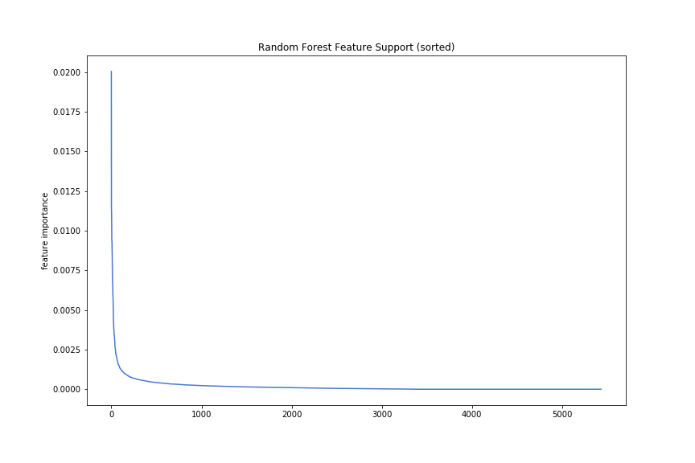
Feature Selection
Feature Importance
Importance order (descending)

Slide 18
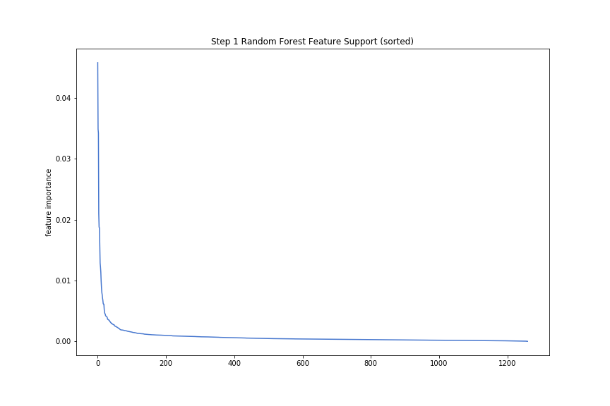
Feature Selection
Feature Importance
Importance order (descending)

Slide 19
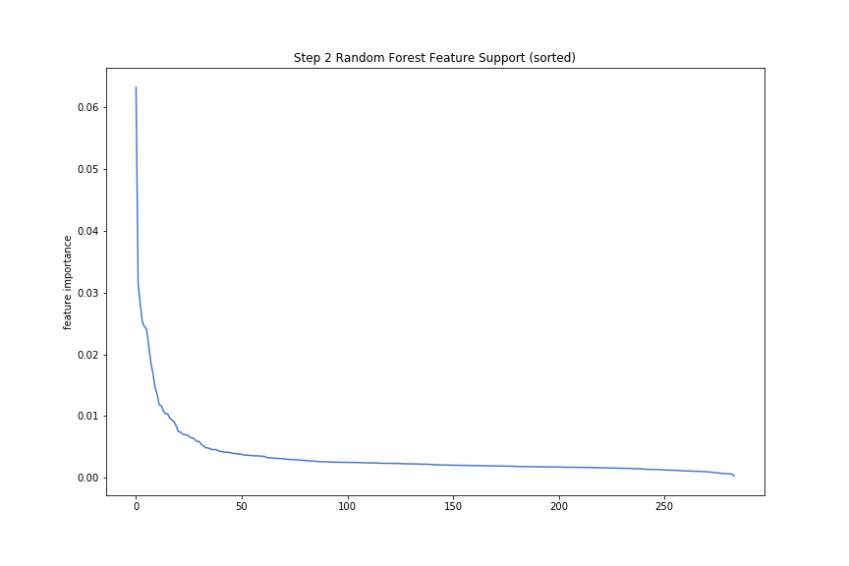
Feature Selection
Feature Importance
Importance order (descending)

Slide 20
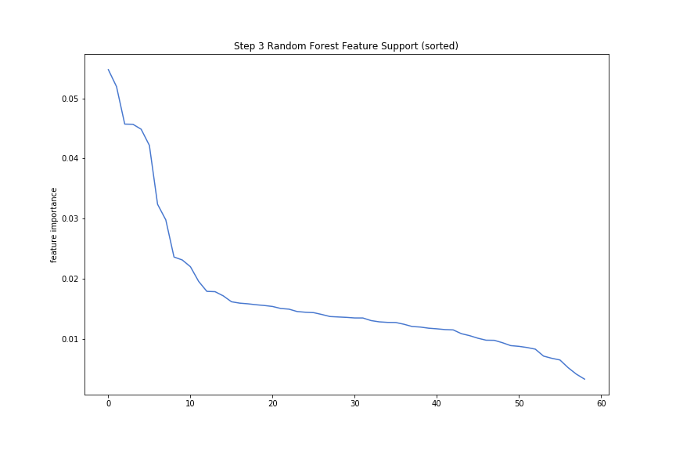
Feature Selection
Feature Importance
Importance order (descending)

Slide 21
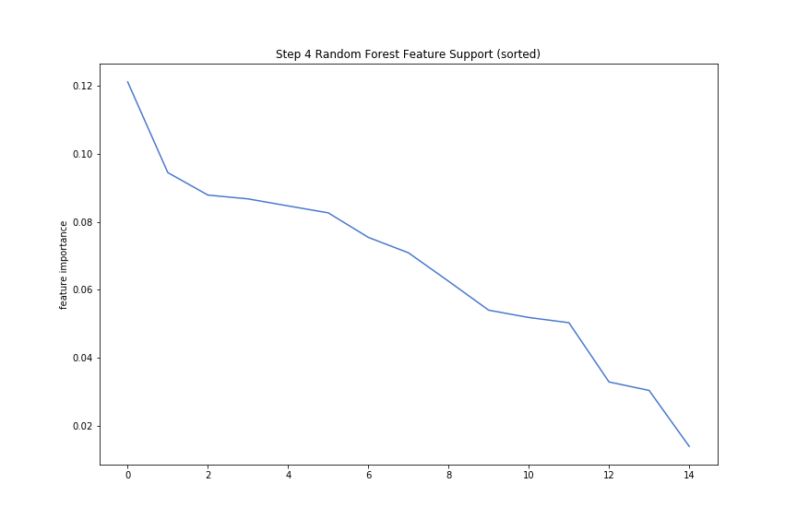
Feature Selection
Feature Importance
Importance order (descending)

Slide 22
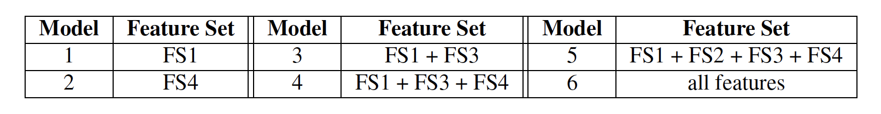
Methods: Evaluation
Feature Set 1 (FS1): selected using entire feature set
Feature Set 2 (FS2): selected using only protein and binding pocket features
Feature Set 3 (FS3): selected using only drug features
Feature Set 4 (FS4): contains only docking features

Slide 23
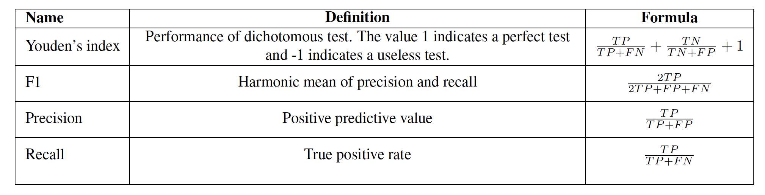
Evaluation Metrics

Slide 24
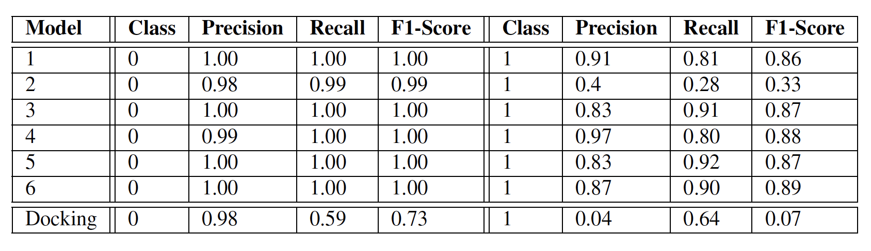
Classification Performance

Slide 25
Conclusions
We found that the features selected from our method greatly increased the performance of binding predictions
Our methods achieve the goal of robustness to class imbalance and are able to extract the important features for the task in a data-driven way
We observe near 60% increase in the success rate for discovering active compounds over molecular docking

Slide 26
Distributed Learning of Molecular Feature Representations

Slide 27
Motivation
Common for modern screening pipeline methods in computational drug discovery to require explicit feature extraction
These features are gathered independently of the end task
Process that still requires some degree of domain expertise

Slide 28
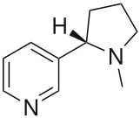
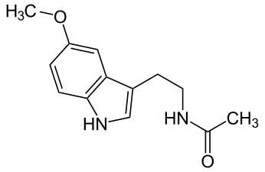
Representing Molecular Structures
Molecule | Structure | SMILES
Nicotine |  | CN1CCC[C@H]1c2cccnc2
Melatonin |  | CC(=O)NCCC1=CNc2c1cc(OC)cc2 CC(=O)NCCc1c[nH]c2ccc(OC)cc12
wikipedia:https://en.wikipedia.org/wiki/Simplified_molecular-input_line-entry_system
Notes:
Here I want to point out that molecules are not as easily represented mathematically as other types of data
A SMILES uniquely describes a structure, and every structure has at least one valid corresponding smiles
Glossed over this in the previous work, but it is important to understand what we are extracting a feature representation from...emphasizing the difficulty of dealing with this data...as opposed to natural types of data like audio or images which themselves are natively defined as vectors in most cases

Slide 29
Related Work: Molecular Descriptors
Output of some computational process “which transforms chemical information encoded within a symbolic representation of a molecule into a useful number...”
Examples may include a measure of a molecules solubility, the number of a certain type of bond, drug-like index, etc;
Notes:
Molecular descriptors are the output of some computational process “which transforms chemical information encoded within a symbolic representation of a molecule into a useful number...”
The winners of the Merck & Co. sponsored Kaggle competition used deep neural networks with molecular descriptors as their features in their submission, showing its ability to outperform the random forest on a collection of 15 datasets (Ma et. al. 2015)

Slide 30
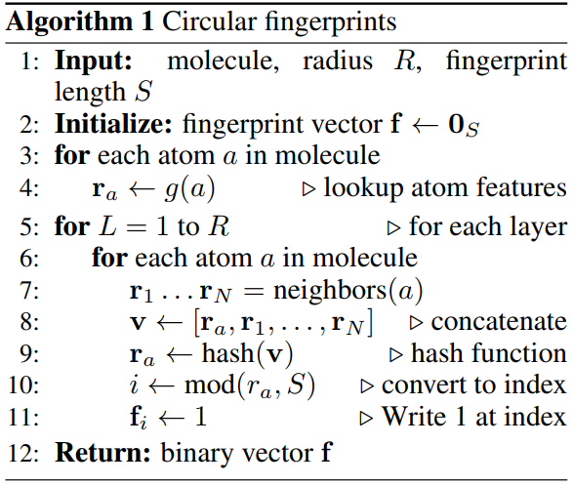
Related Work: Molecular Fingerprinting
Compute a unique binary valued vector that identifies a molecule based upon the atoms that it contains and their features
Often used for computing similarity between molecules
Taken from duvenaud et.al (2015)
Notes:
Compute a vector representation that identifies the molecule in a vector space with some intrinsic meaning, rather than a single scalar value

Slide 31
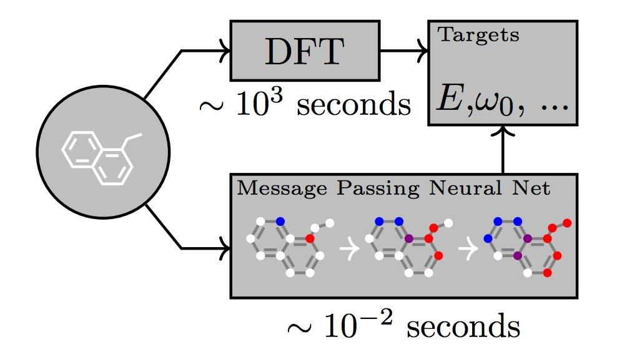

Related Work: Neural Fingerprinting and Molecular Graph Convolutions
Duvenaud et. al. propose a fingerprinting method that uses a differentiable function
Variations on this idea have been proposed and provided via deepchem
Gilmer et. al. present a comprehensive survey of current techniques under the name “message passing neural networks” or MPNNs
Notes:
Duvenaud et. al. propose a fingerprinting method that uses a differentiable function - producing a real valued fingerprint optimized for the task
The Pande group of Stanford have played a large role in the development of these molecular graph algorithms and for promoting their use via deepchem

Slide 32
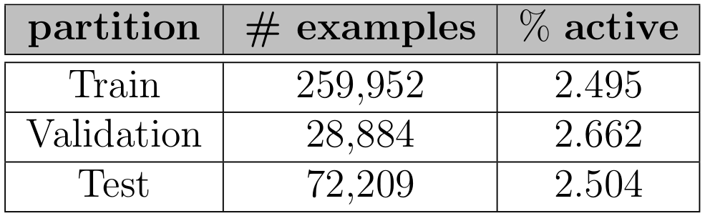
Dataset Description
molecular properties
smiles
active/decoy
drug_{1,1}:protein_{1,1}
.
.
.
.
.
.
.
drug_{n,26}:protein_{26,1}
(0,1)
.
.
.
.
.
.
.
(0,1)
Collect the drug molecules and their targets from DUD-E
Training/Testing sets generated using an 80/20 stratified split
Training/Validation sets generated using a 90/10 stratified split
Dragon 7 software to extract molecular properties
Notes:
Training/Validation sets generated using a 90/10 stratified split

Slide 33
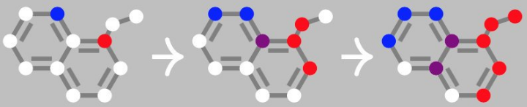
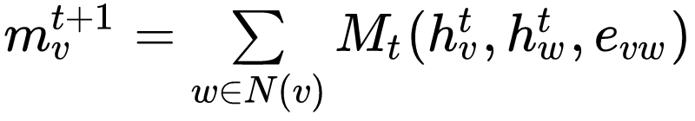
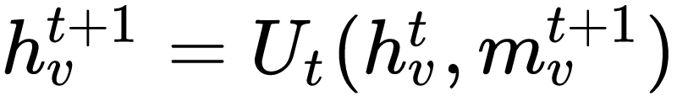
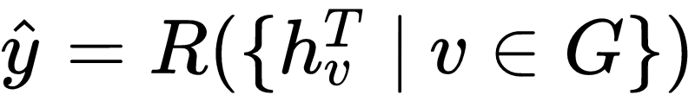
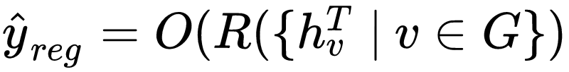
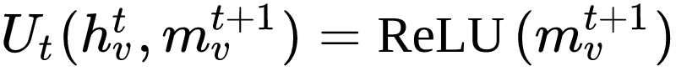
Network Description
Message Passing Phase:
Readout Phase:
We define:
Notes:
We use the rdkit library to construct molecular graphs from the smiles
We use the deepchem library to extrat atom features (70) and bond features (6-binary vector indictating bond type)

Slide 34
Network Training
Practical issues with the MPNN motivated the need to think of ways to improve the speed of training
We use the HOGWILD! Asynchronous SGD algorithm as a potential solution to this problem
Notes:
Have not conclusively figured a way

Slide 35
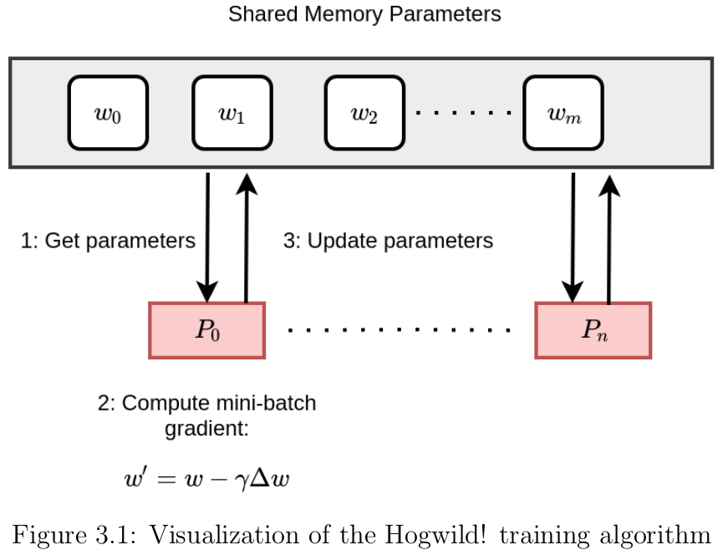

Slide 36
Results: Experiment 1 - Predicting Molecular Properties
In our first set of experiments, we are interested in the MPNNs ability to learn meaningful feature representations
We use the set of molecular properties from the Dragon 7 software as our targets
Idea: If this can be done, perhaps more complicated tasks are possible
Minimize the MSE using the ADAM optimizer with learning rate = 1e-3

Slide 37
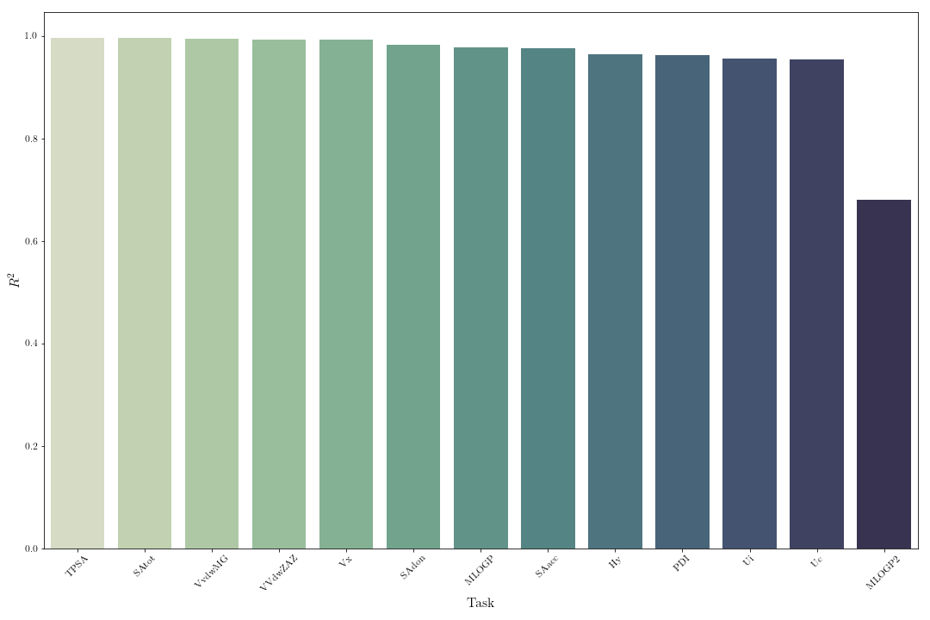
Results of Molecular Property Predictions

Slide 38
Results: Experiment 2 - Binding Affinity Classification
Goal 1: can we achieve comparable performance to our previous methods using only the drug molecular structures as our input?
Goal 2: can we use a distributed training algorithm to reduce training time?
Evaluated 100 settings of hyperparameters to find best set, then vary the number of training processes
Minimize the cross entropy loss using ADAM optimizer with HOGWILD! training

Slide 39
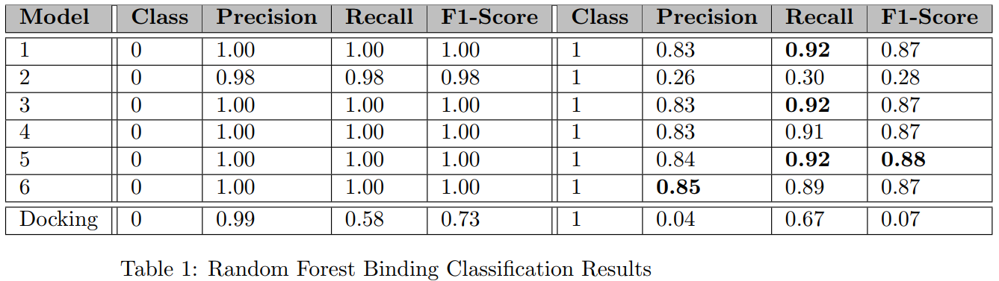
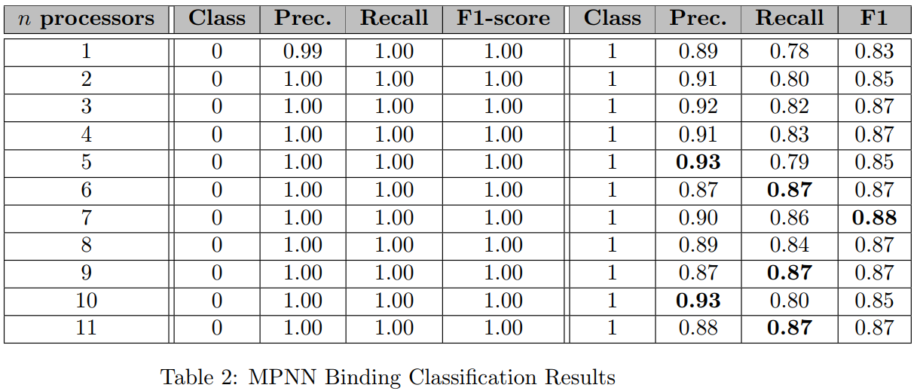
Old Method
New Method
Results of Binding Affinity Classification
Notes:
Can compare only to model 1

Slide 40
Conclusions
Each of the MPNN models exceeds the maximum precision score of the Random Forest method
We can match the best F1-score with the previous method
By using only the molecular structures of the drug molecules, we have demonstrated that we can learn optimized features that drastically reduce the computational overhead and size of the dataset used for making this prediction
Notes:
The MPNN is able to perform competitively with methods using explicit feature extraction

Slide 41
Future Directions
Visualize the learned features
HOGWILD! can work but is it the best approach to scaling the MPNN?
Can we find more clever ways to speed up the training? Architecture or Optimization?
How about using synchronous distributed optimization algorithms?
What about multi-task learning with unscaled targets?

Slide 42
Acknowledgements
UK Markey Cancer Center
UK CCS
National Energy Research Scientific Computing Center (NERSC)
National Institutes of Health (NIH)

Slide 43
Questions?

Slide 44
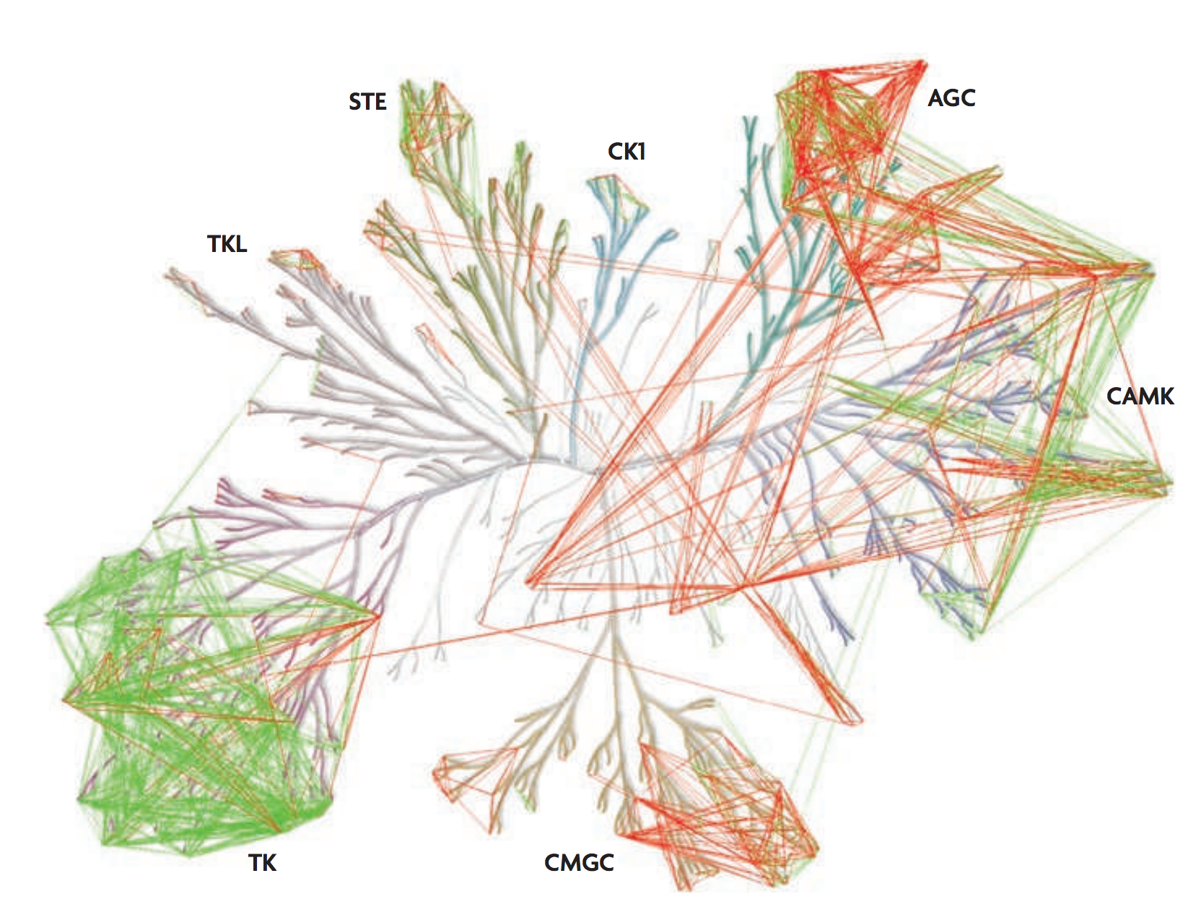
Selectivity in Kinases
Pairs of kinases that were potently inhibited by a common inhibitor (green lines) were used to determine a sequence similarity cut-off to predict pairs of kinases that can be inhibited by a common inhibitor (red lines)

